Slide 1
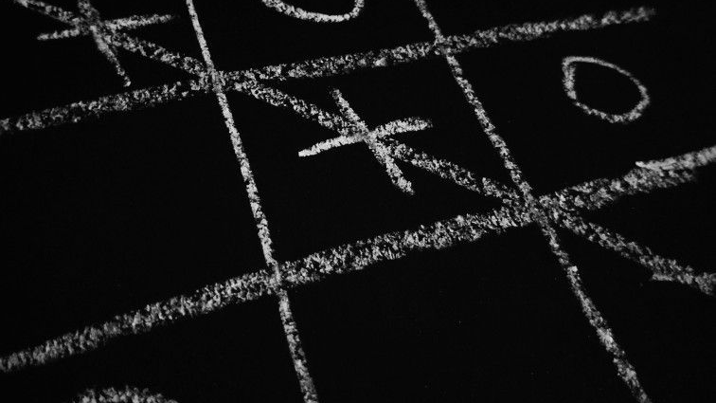
Tic tac toe
Team 2 in ai workshop
Students in the Faculty of Computers and Artificial Intelligence at Helwan University

Slide 2
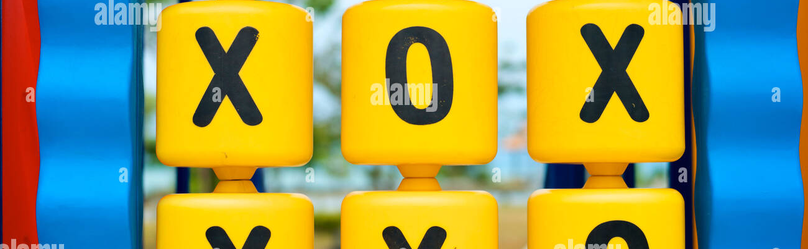
Content of presentation
Gui
Minimax
main functions in code
Flowchart (1 & 2)

Slide 3
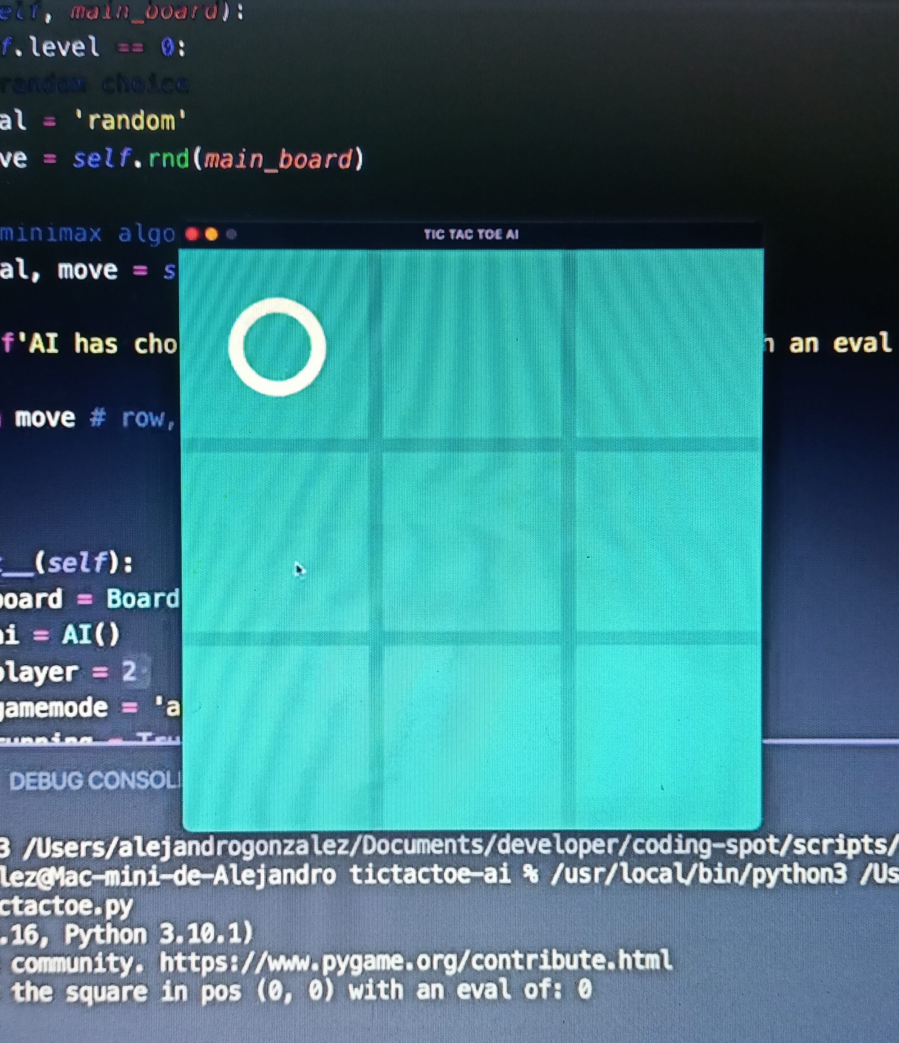
Gui
Gui
In short
1-Designing the visual composition and temporal behavior of a GUI is an important part of software application programming in the area of human–computer interaction
2-Methods of user-centered design are used to ensure that the visual language introduced in the design is well-tailored to the tasks
3-The term GUI tends not to be applied to other lower-display resolution types of interfaces, such as video games (where HUD (head-up display)[9] is preferred), or not including flat screens like volumetric displays[10] because the term is restricted to the scope of 2D display screens able to describe generic information
4- In this game it was used so that each player can play clearly and clarify the Empty Square and which of the players won and which of them lost
Examples
1-Atm &Point of sale
2-Screen (windows , android)
3-Games example tic tac toe
4-navigation systems in cars

Slide 4
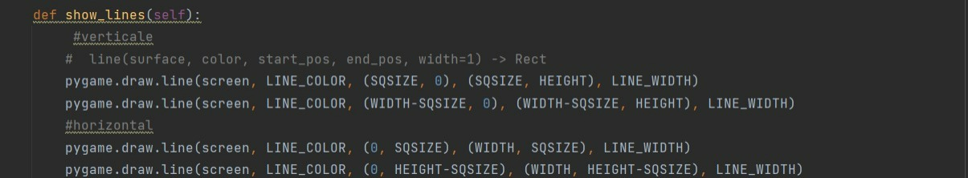
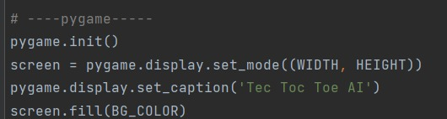
Main functions function( show_ lines (self)) Responsible for draw rows and columns
Main functions
this code Responsible for show a gui screen in windows screen , show name (tic tac toe) and color

Slide 5
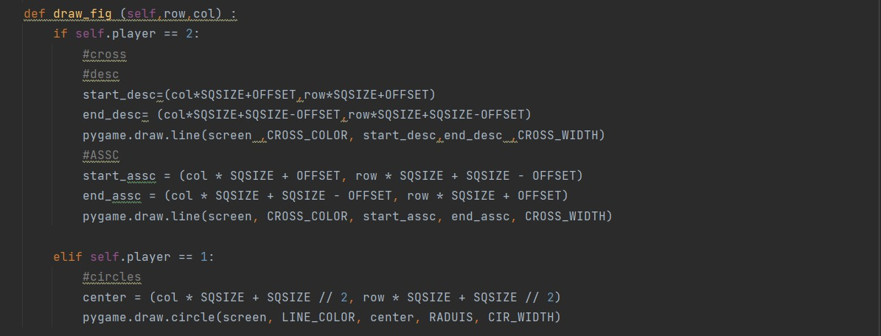
Function( draw_ fig (self , row, col) take two parameter and responsible for first player(who take first step) play by(x), DESC responsible for make right line ,ASSC responsible for make left line.
second player play by (o). Self. player ==1 responsible for

Slide 6
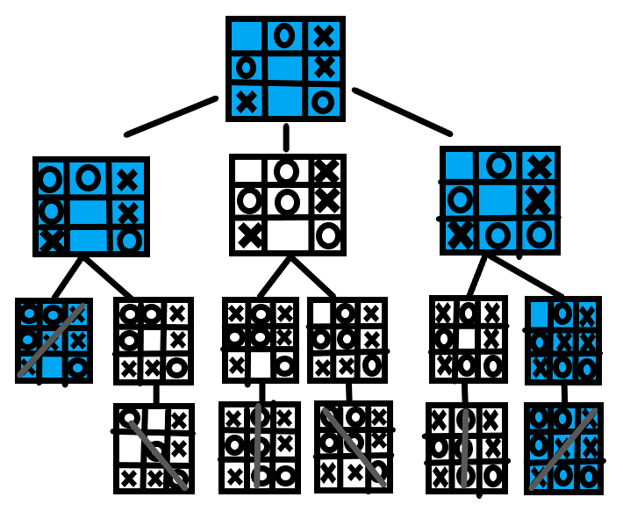
Minimax In decision-making and game theory, the mini-max algorithm is a recursive or backtracking method. It suggests the best move for the player, provided that the opponent is likewise playing well. •In AI, the Min-Max algorithm is mostly employed for game play. Chess, checkers, tic-tac- toe, go, and other two-player games are examples. This Algorithm calculates the current state's minimax choice. •The game is played by two players, one named MAX and the other named MIN, in this algorithm. •Both players FIGHT it, since the opponent player receives the smallest benefit while they receive the greatest profit. •Both players in the game are adversaries, with MAX selecting the maximum value and MIN selecting the minimum value. •For the exploration of the entire game tree, the minimax method uses a depth-first search strategy. •For the exploration of the entire game tree, the minimax method uses a depth-first search strategy. •The minimax algorithm descends all the way to the tree's terminal node, then recursively backtracks the tree.
Minimax

Slide 7
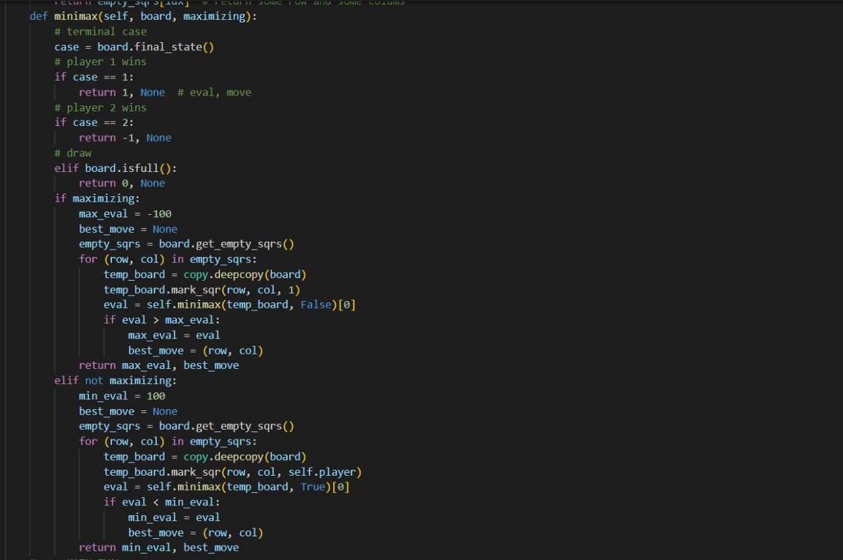
Minimax algorithm in code
Minimax algorithm in code

Slide 8
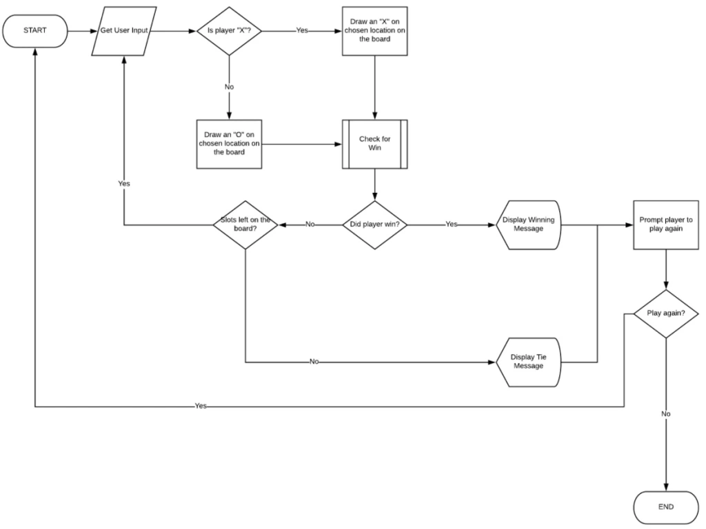
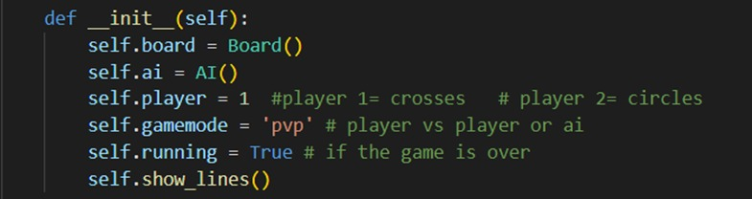
Flowchart 1 (human vs human) in this case human with human any one will play first, frame change after every step and ask if any one win or not and game goes on in last step if one win game end ,if no one win game will repeat in this picture we have case if and only if self.player =1 , human play with human
Flowchart

Slide 9
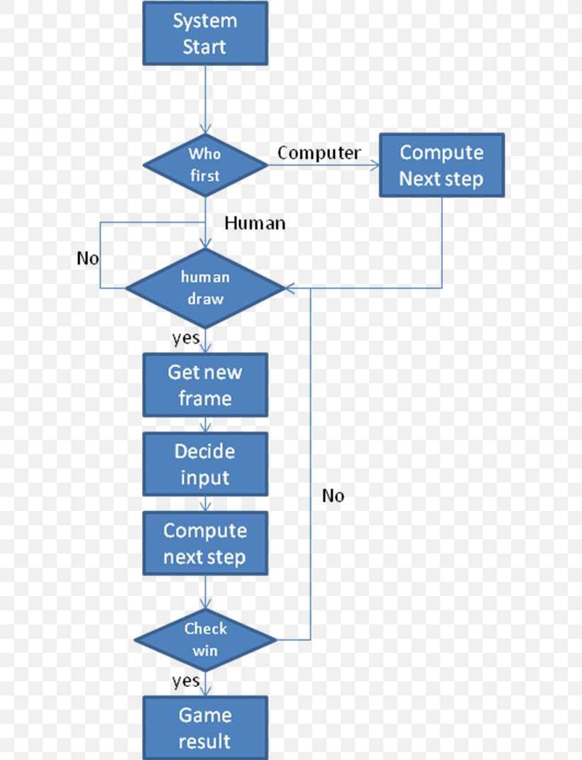
Flowchart 2 human vs computer) in this case human will play first and each time he play frame change and computer play next and compute next step after that ask if any one win game will end if not repeat game in this game we have default value ,so when the game startGameMode =‘ai’ is human to ai
Flowchart

Slide 10

Thank You
Thank You
Name of project :Tic tac toe
BY:TEAM 2
MSP’22 AI WORKSHOP

